Slide 1
Building a Stronger Extension Brand
Together, We Can!
Elizabeth Gregory North
Head, Agricultural Communications
Mississippi State University Extension Service

Slide 2
A little history
2008-2012: ECOP supported the National Extension Branding Initiative.
Research: Copernicus Marketing & Research of Boston
Quantitative and qualitative phases: foundational research to identify Extension’s brand value, analysis and further research to validate those value statements, evaluation of the effectiveness of potential brand messages.
Planning, Design, & Implementation: strategy, messages, design templates, and branding training developed and shared throughout the system.
Notes:
Beginning in 2008, the Extension Committee on Organization & Policy supported work on a National Extension Branding Initiative.
It began with research conducted by Copernicus Marketing & Research of Boston, a nationwide study of Extension’s brand and what it means to us, to Extension volunteers, to Extension clients, and to people who don’t even know us yet.
It included both quantitative and qualitative phases, beginning with the foundational research to identify Extension’s brand value and ending with focus groups to evaluate the effectiveness of potential brand messages.
The work continued with a design and implementation phase, during which messages, design templates, and branding training were developed and shared throughout the system.
Many institutions adopted the messaging and used or adapted the templates, and many individuals took the training.

Slide 3
Yet challenges remain
The forces that fragment our brand are still at work:
The diversity and variety of our subject matter.
Extension personnel who identify themselves or their programs with their university, rather than with Extension.
Notes:
The forces that fragment our brand are still at work:
The diversity and variety of our subject matter, which is one of our greatest strengths, is also one of the strongest forces fragmenting our brand.
Extension personnel who, when dealing with the public or funding stakeholders, identify themselves or their programs with their university, rather than with Extension. Our people and our programs are our greatest value and our primary client touchpoints, and, when they are not identified with Extension, the opportunity to grow Extension’s brand recognition and value is lost.

Slide 4
So why does that matter?
If no one knows who we are,
If no one knows whose programs they have benefited from,
If no one knows the value Extension provides,
Then no one recommends us to their friends.
Then no one supports us or advocates for us.
Then no one funds us.

Slide 5
How do you build a strong brand?
Option 1.
A national, multimedia advertising campaign
Cost? $100 million, minimum

Slide 6
How do you build a strong brand?
Option 2.
Leverage Extension’s scale through the use of a shared, consistent brand framework and messaging strategy.
Cost? 0

Slide 7
How do you build a strong brand?
Building a strong brand takes
    a clear and compelling message
    validated by research
    focused on the audience
    consistently and repeatedly
    communicated, delivered, and
    experienced.

Slide 8
Branding is not just a communications activity
Branding in Extension is everyone’s
responsibility, every day, in every
interaction.
Strong branding practices build strong
recognition for Extension.
Every use of the Extension brand builds
on all the others. Done correctly, it all
adds up!

Slide 9
Branding is not just a communications activity
It is critically important that we
understand what our brand means to
our stakeholders.
And that we align not only our
communications but our policies, procedures,
and personnel to deliver that meaning in
every interaction.

Slide 10
A reminder of the research findings
Most of all, people want a resource they can trust.
They also want convenient access to the best information and
knowledgeable, committed staff they can turn to for help.
The research shows that Extension has these things, and more.

Slide 11
Motivating messages
Highly Motivating Characteristics
        Trustworthy Source
        Great Staff
        Convenient Access
        Current, Reliable Information
        Expert Review
        Quality of Life

Slide 12
Motivating messages, 2
Moderately Motivating Characteristics
        Change Agents
        Scope of Work
        In-Person Support
        University Connection

Slide 13
Motivating messages, 3
Less Motivating Characteristics
        Century of Experience (22)

Slide 14
Inconsistent brand messaging
Source A
Source B
Source C
Source D
Message A
Message B
Message C
Message D
Audience A
Audience B
Audience C
Audience D

Slide 15
Consistent brand messaging
Sources A, B, C, D
Consistent Message
Audience A
Audience B
Audience C
Audience D

Slide 16
Extension’s Brand Promise
Extension provides practical education you can trust
to help people, businesses, and communities
solve problems, develop skills, and build a better future.

Slide 17
Extension’s National Branding campaign theme
Explains what “Extension” means
Our impact
Extending knowledge. Changing lives.
What we do
Not just information, but education

Slide 18
Message framework
High-quality environmental portraits of happy clients, proud of their success.
Quotes from clients, word-of-mouth testimonials.
Simple layout, strongly graphic.
Friendly, upbeat tone.
Language is easy to understand, but not “dumbed down.”
Complete focus on client.

Slide 19

Examples

Slide 20
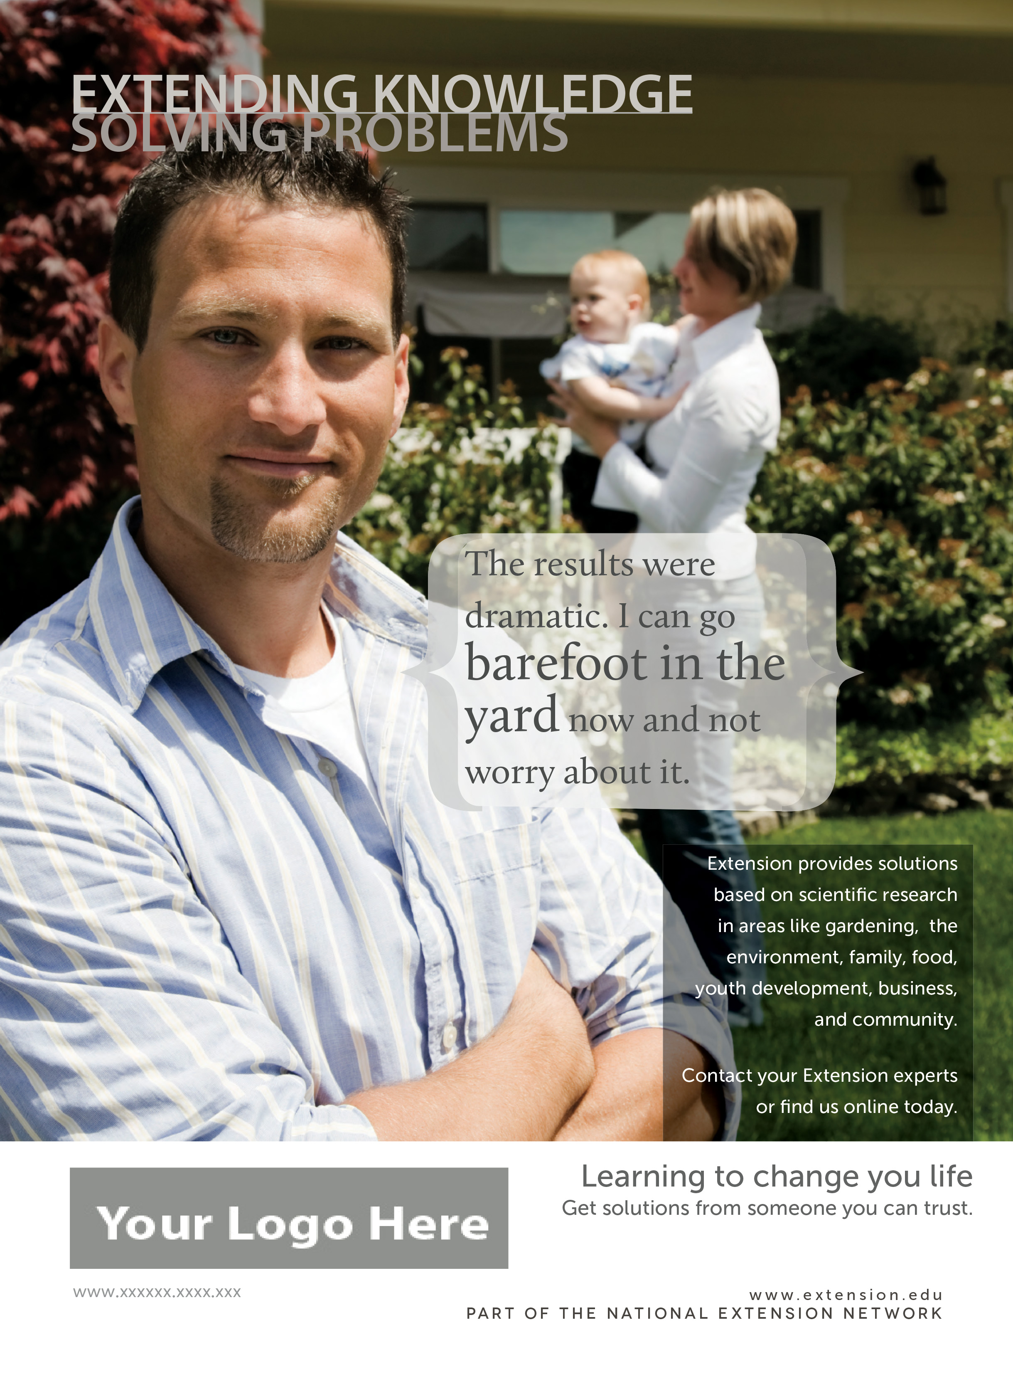
Examples

Slide 21

Examples

Slide 22

Examples

Slide 23

Examples

Slide 24
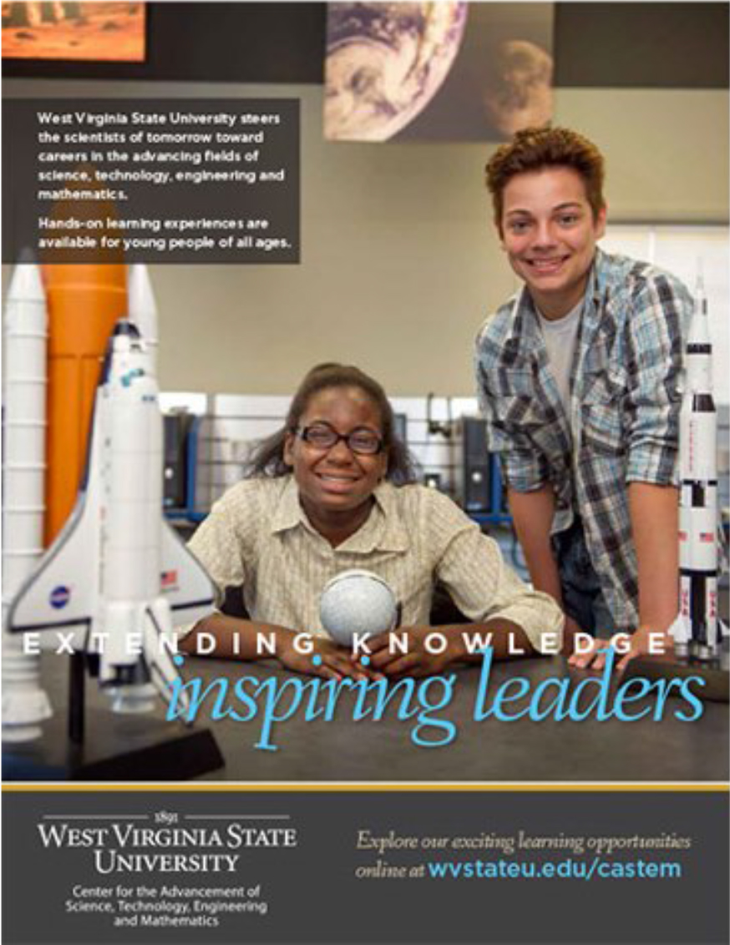
Examples

Slide 25

Examples

Slide 26
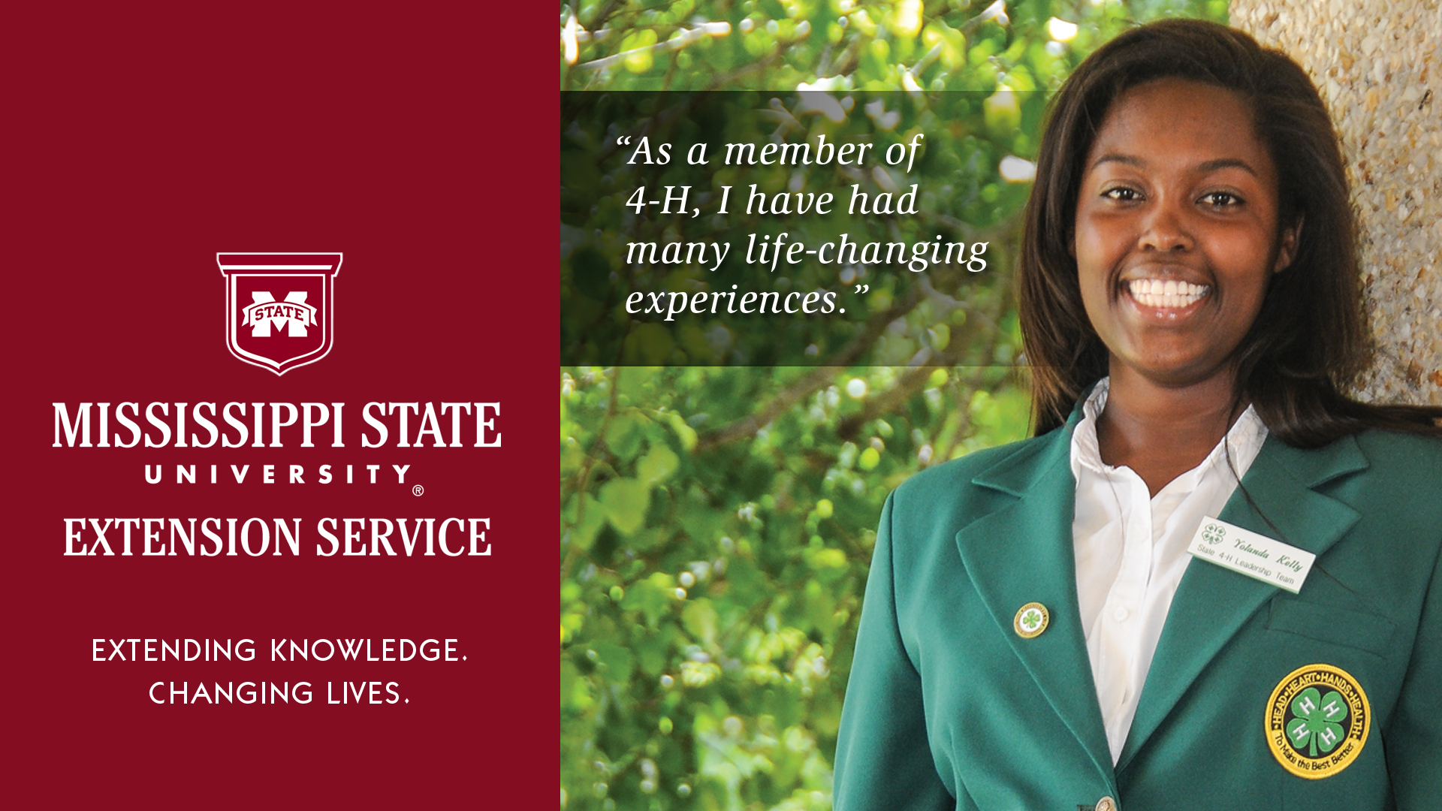
Examples

Slide 27
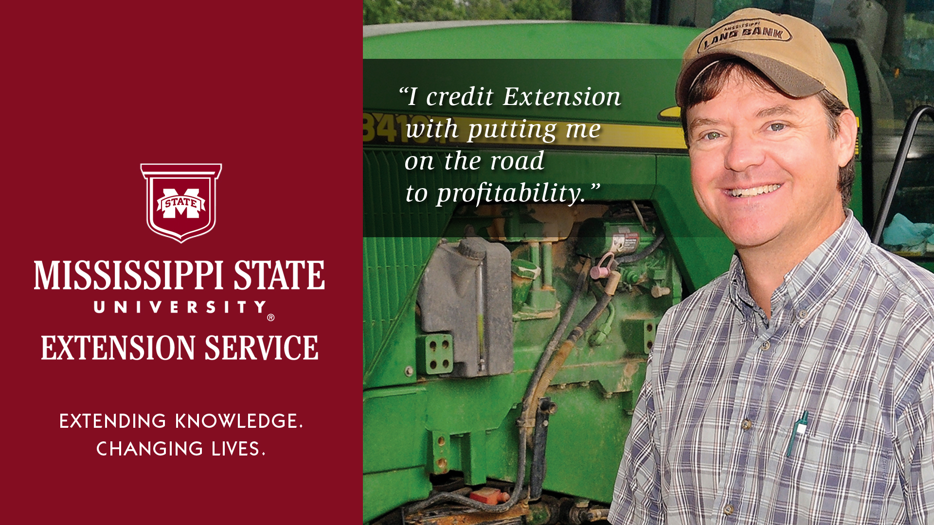
Examples

Slide 28
National Branding Initiative Research and Resources
Find the webinars, messages, tools,
templates, and training
within the Brand Value CoP on eXtension:
http://create.extension.org/node/93266

Slide 29
Extension provides practical education you can trust
to help people, businesses, and communities
solve problems, develop skills, and build a better future.
Notes:
Guy Kawasaki, former brand evangelist for Apple, and now a widely renowned marketing advisor and consultant, says, “Good marketing can’t fix bad reality.” We know from the research that Extension has great reality—we are highly valued by those we work with. We just need to make sure that people know that value comes from Extension. We can do this, together!

